Slide 1

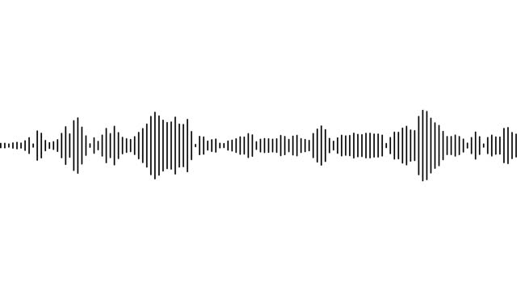
Style Transfer of Audio Effects with Differenciable Signal Processing
Adhémar de Senneville
Input Sound
Output Sound
Reference Sound

Slide 2


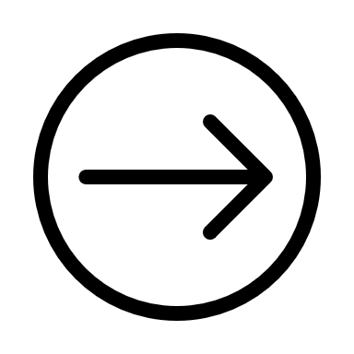

Main Approaches
Audio engineering
Data-driven : Parameter prediction
Direct transformations
Differentiable Signal Processing
Not automatic
Need data
No interpretability
Tested in the paper

Slide 3
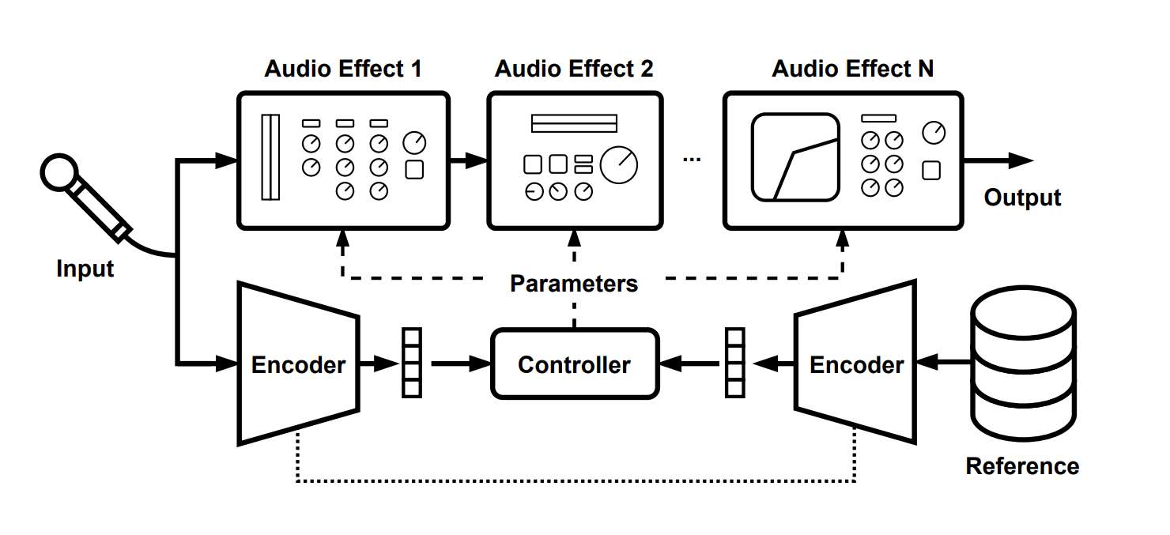
DDSP : Automatic and Interpretable

Slide 4
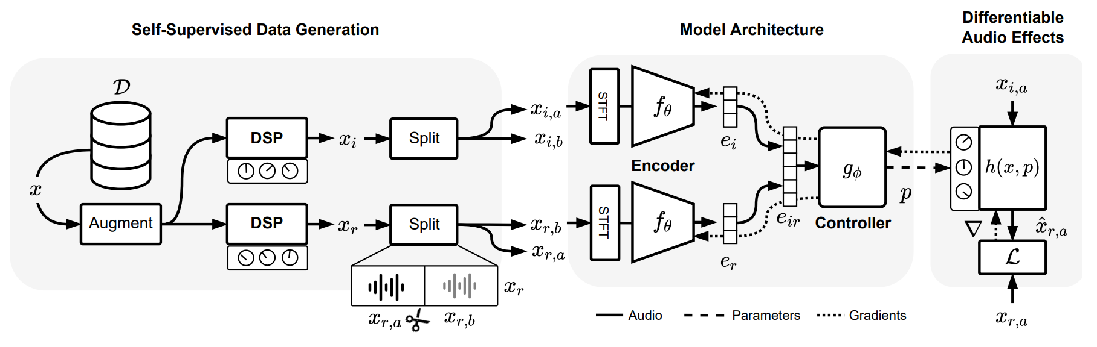
DDSP : Data driven

Slide 5


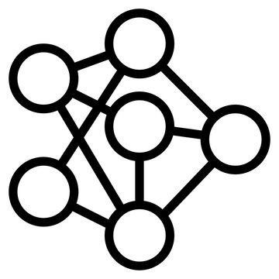
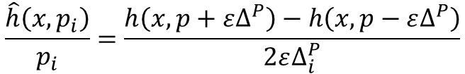
Differentiable signal processing
Auto differentiation (AD)
Numerical Gradient
Neural Proxies (NP)
$$\frac{\hat{h}\left(x,p_{i}\right)}{p_{i}}=\frac{h\left(x,p+ε∆^{P}\right)−h\left(x,p−ε∆^{P}\right)}{2ε∆_{i}^{P}}$$

Slide 6

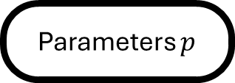


My training
Audio Effect
Input Sound $x$
Output Sound $\hat{y}$
Time/Frequency Loss
Parameters $p$
Gound Truth $y$

Slide 7
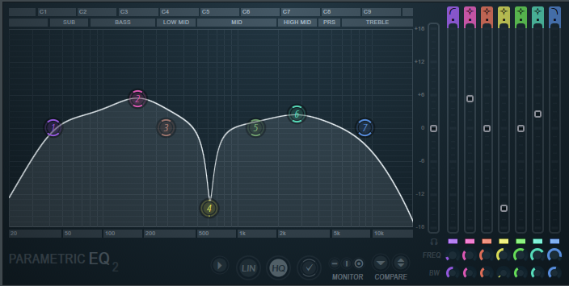
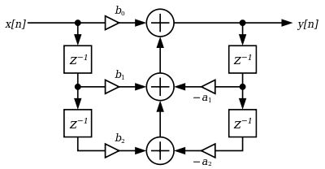
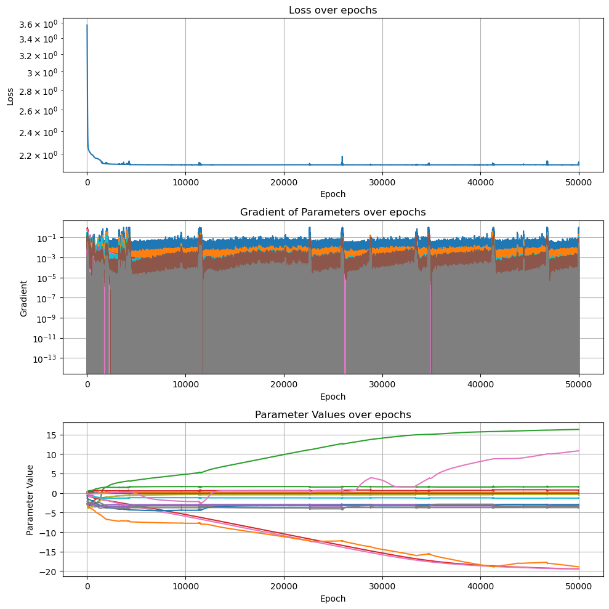
Differentiable Parametric EQualizer
Biquad IIR Filter cascade
$$y\left(n\right)=b_{0}x\left(n\right)+b_{1}x\left(n−1\right)+b_{2}x\left(n−2\right)− a_{1}y\left(n−1\right)–a_{2}y\left(n−2\right)$$

Slide 8
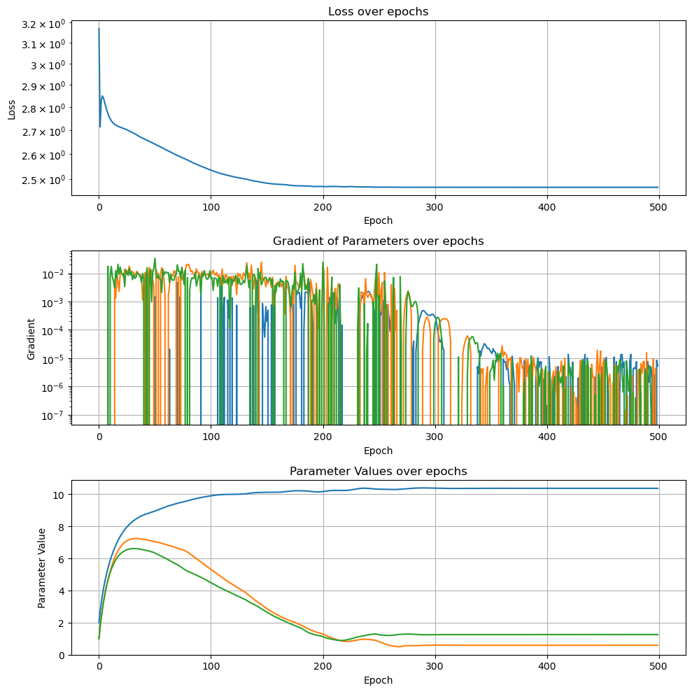
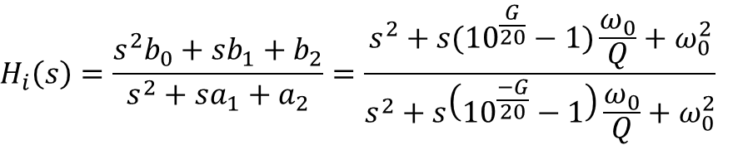
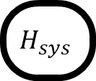
Differentiable Parametric EQualizer
Biquad FIR Approximation
$$H_{i}\left(s\right)=\frac{{s^{2}b}_{0}+sb_{1}+b_{2}}{s^{2}+sa_{1}+a_{2}}=\frac{s^{2}+s({10}^{\frac{G}{20}}−1)\frac{ω_{0}}{Q}+ω_{0}^{2}}{s^{2}+s\left({10}^{\frac{−G}{20}}−1\right)\frac{ω_{0}}{Q}+ω_{0}^{2}}$$
FFT
$$H_{sys}$$
iFFT

Slide 9
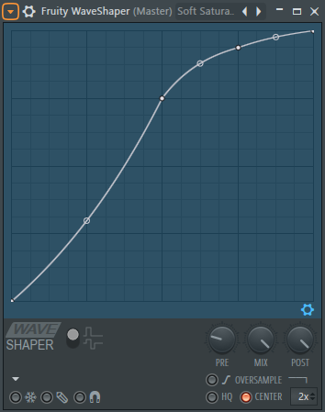
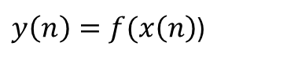
Differentiable WaveShaper
$y\left(n\right)=f(x\left(n\right)$)
Simple Operation (Computation Cost)
Nonlinear operation → Big Frequency enhancement
High Expressivity

Slide 10
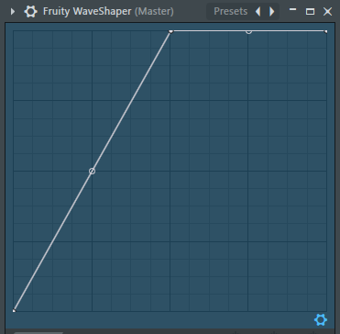
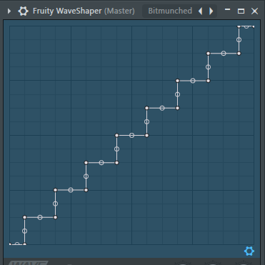
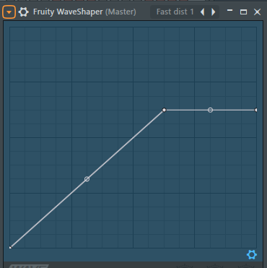
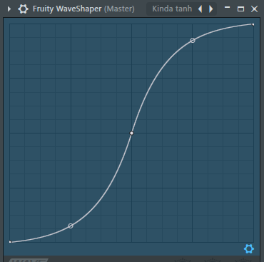
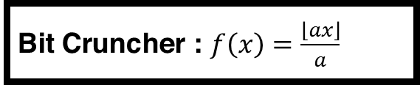
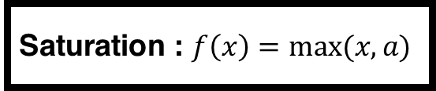
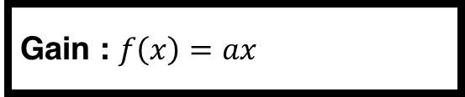
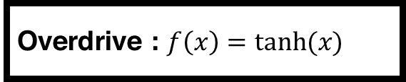
High Expressivity
Gain : $f\left(x\right)=ax$
Bit Cruncher : $f\left(x\right)=\frac{\left\lfloor ax\right\rfloor }{a}$
Saturation : $f\left(x\right)=max⁡(x,a)$
Overdrive : $f\left(x\right)=tanh⁡(x)$

Slide 11
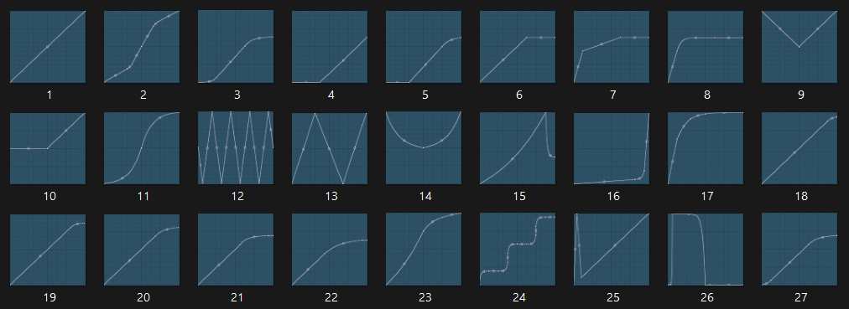
FL-Studio WaveShaper Dataset
Objective: Get a Low number of parameter, high expressiveness , differentiable WaveShaper.

Slide 12
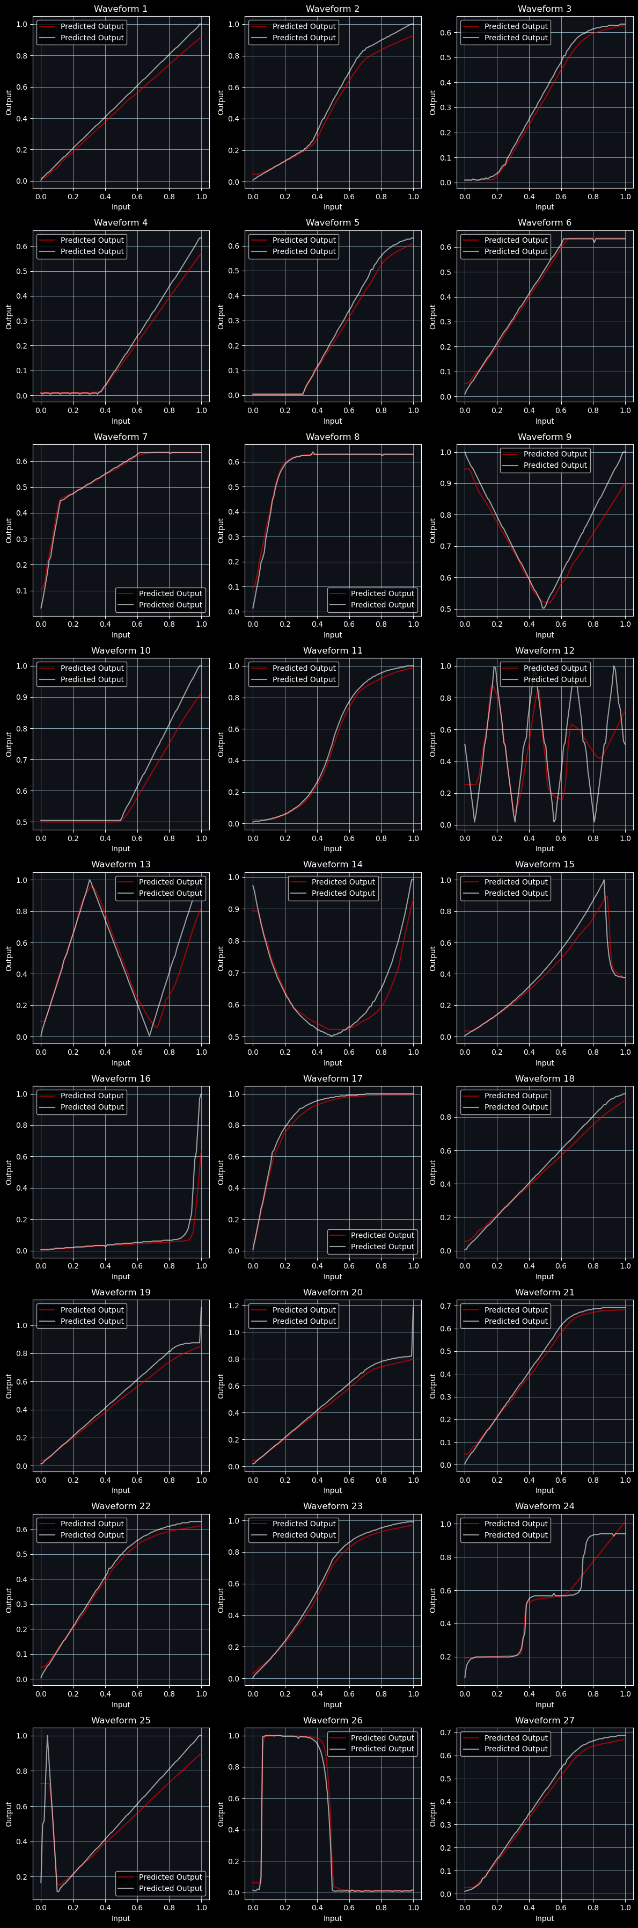
0 – Using MLPs

Slide 13
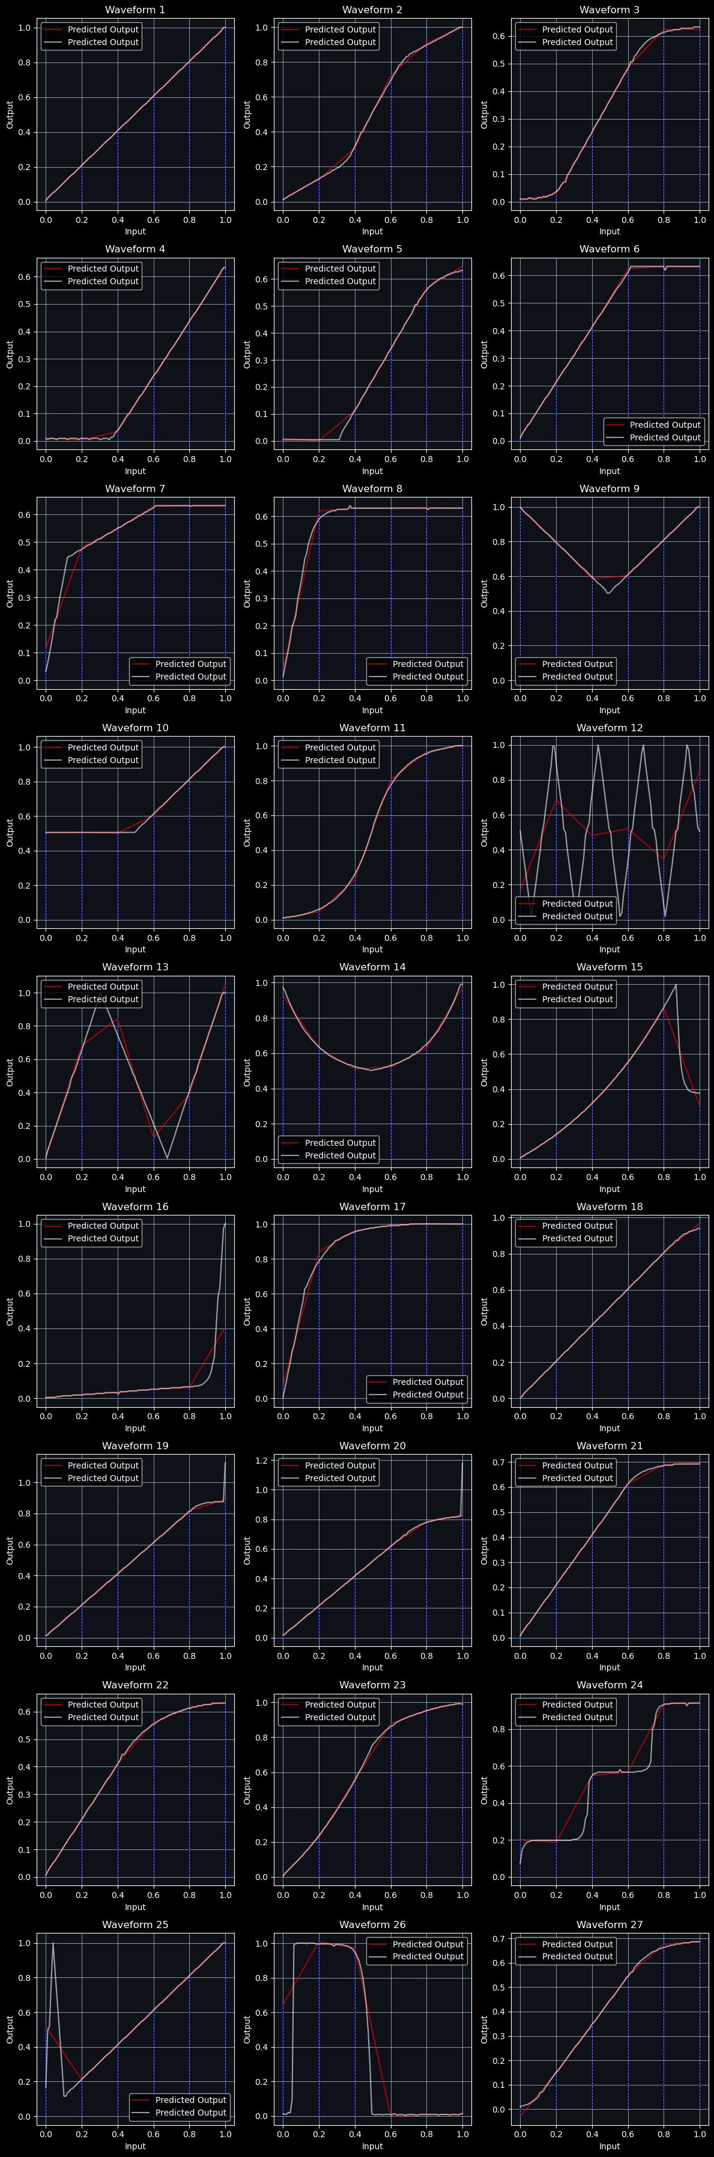
1 – Using Linear Interpolation

Slide 14
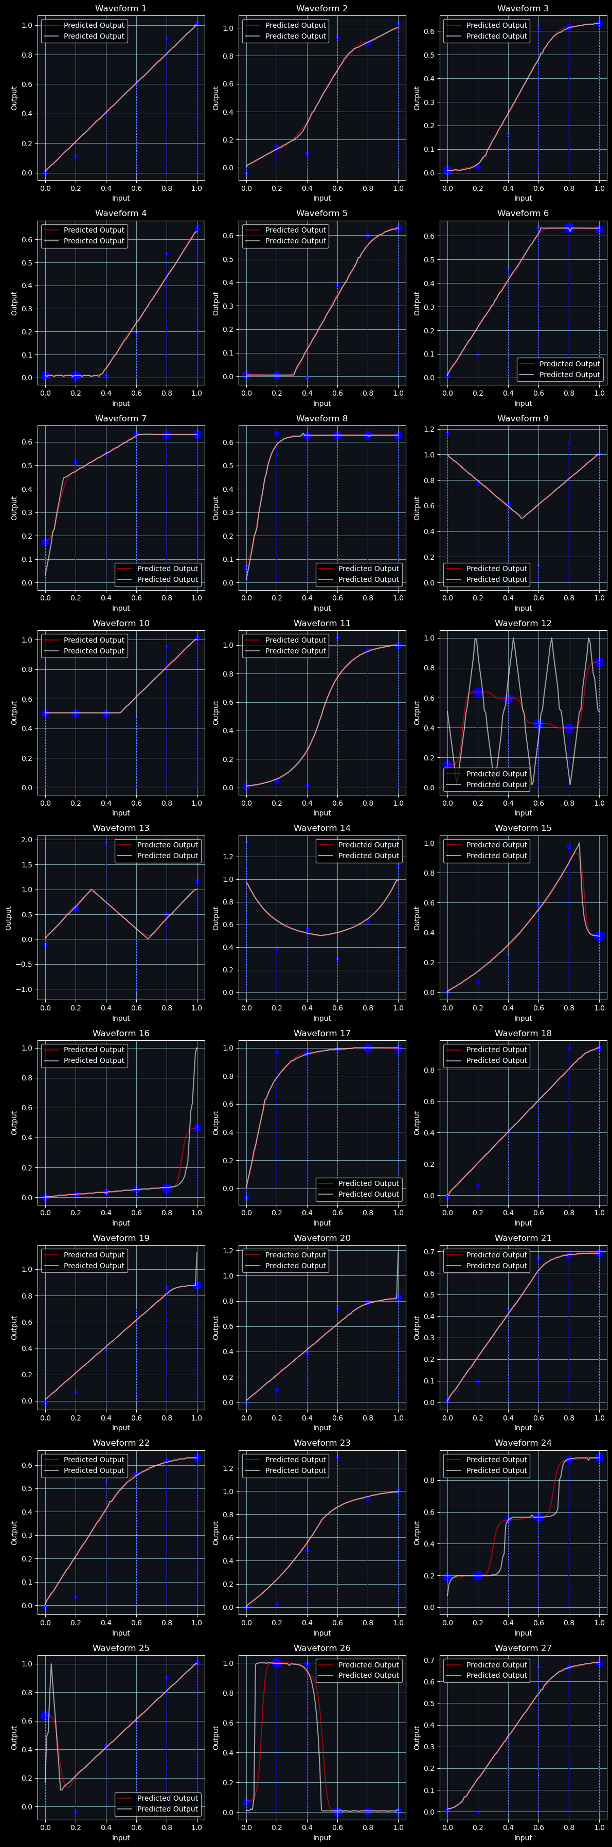
2 – Using Parametrized Interpolation

Slide 15
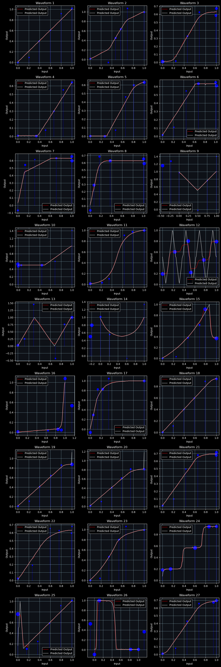
3 – X and Y positions

Slide 16
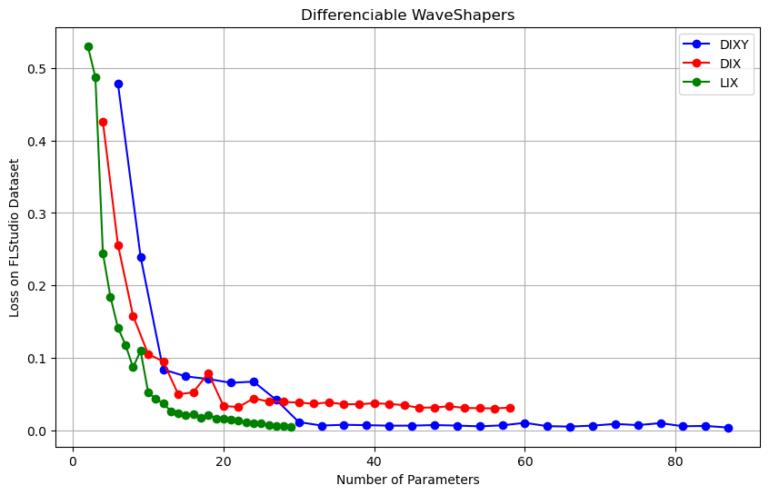
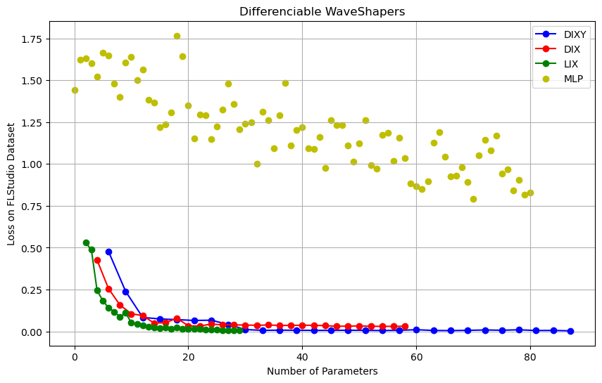
Differentiable WaveShaper
Interpol XY
Interpol Y
Linear Y
Interpol XY
Interpol Y
Linear Y

Slide 17
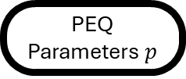
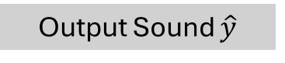
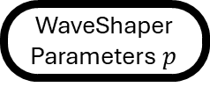


Conclusion
PEQ
Wave Shaper
Input Sound $x$
Output Sound $\hat{y}$
Time/Frequency Loss
PEQ Parameters $p$
WaveShaper Parameters $p$
Gound Truth $y$

